Slide 1
The United States Opioid Epidemic:
Team Members:
Virendra Chauhan
Lin Fu
Rashmi Ray
Rene Lizarraga

Slide 2
Opioid Epidemic
The opioid epidemic is the rapid increase in the use of prescription and non-prescription opioid drugs in The United States.
Opioids are a diverse class of strong painkillers such as Oxycodone/Hydrocodone, Fentanyl/Tramadol, Methadone and recreational drug such as Heroine.
The availability of these substances, despite their high risk of addiction and overdose, have made them popular both as medical treatment and as recreational drug.
Due to their sedative effects on the part of brain, high dose can cause respiratory failure which leads to sudden death.

Slide 3
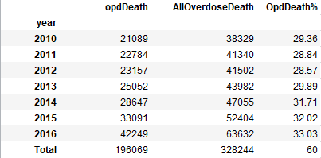
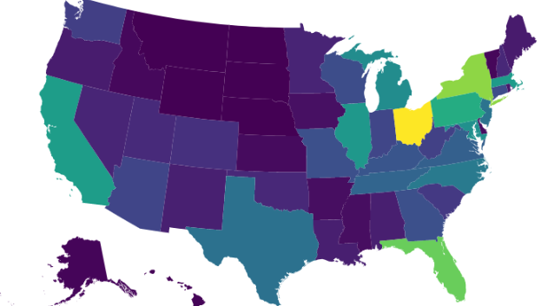
Opioid Death Across Nation
Based on CDC Data we collected from 2010-2016.
328,000+ Americans died from Drug over dose in 50 states.
196,000+ Americans died from opioid related overdose.
Based on the data, 60% death contributed by opioid overdose.
In 2016 only, Opioids are responsible for 33% of overdose deaths which is 42,249 (opioids deaths) out of 63,632 (Total Overdose Deaths).
196,069
Opioid Deaths

Slide 4
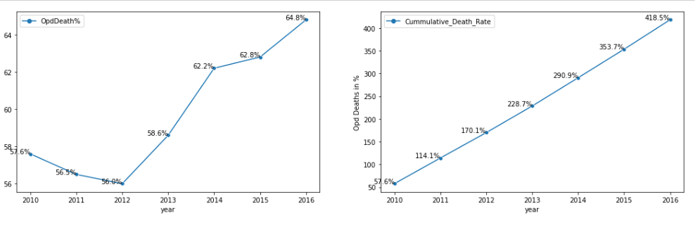
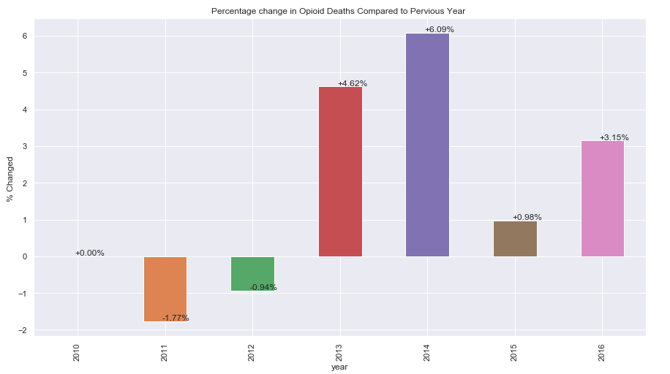
Rate of Opioid Deaths
The rate of increase in opioid overdose deaths has been dramatic.
There is significant increase in death rate after 2012.
Since 2010, cumulated opioid death rate has increased by 418%.
In 2016 , death rate has increase from 62.8% to 64.8% ( +3.15%), while from 2013-2014 sudden increase was from 56% to 62.2%.

Slide 5
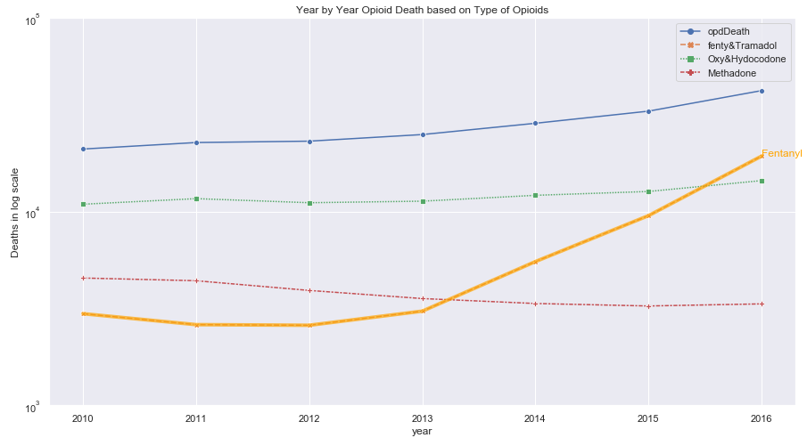
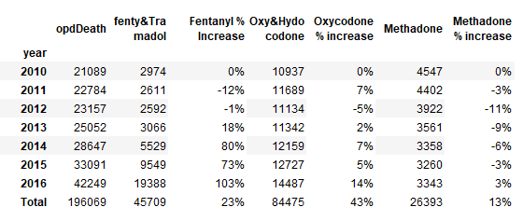
Cause of death by Drug Type (2010-2016)
Oxycodone contributed 43% deaths by overdose since 2010.
Fentanyl was responsible for 23% death caused by overdose since 2010.

Slide 6
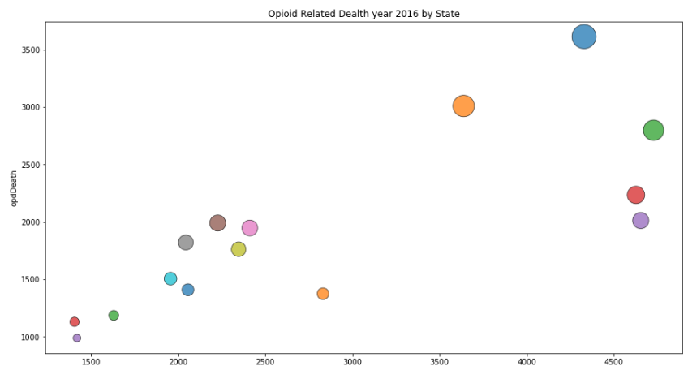
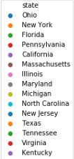
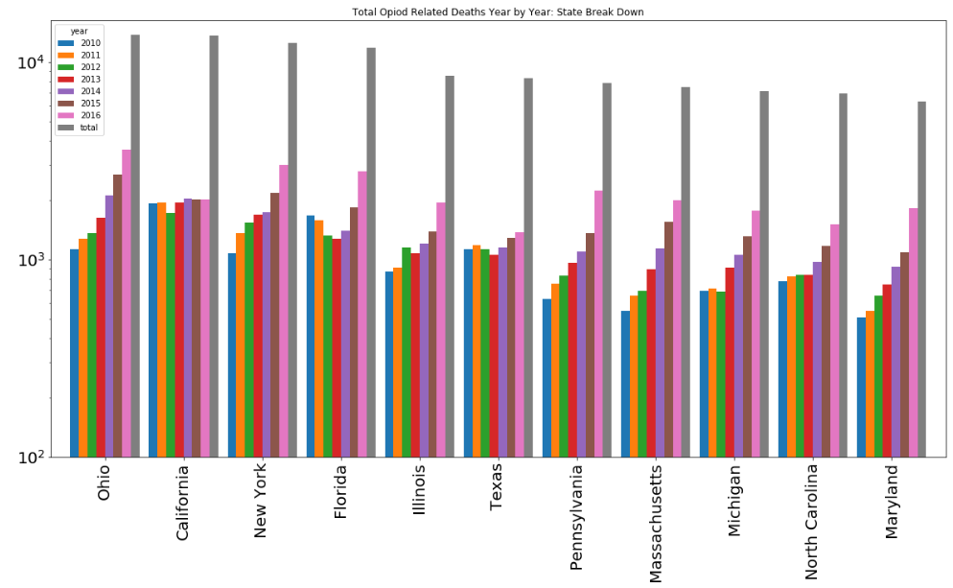
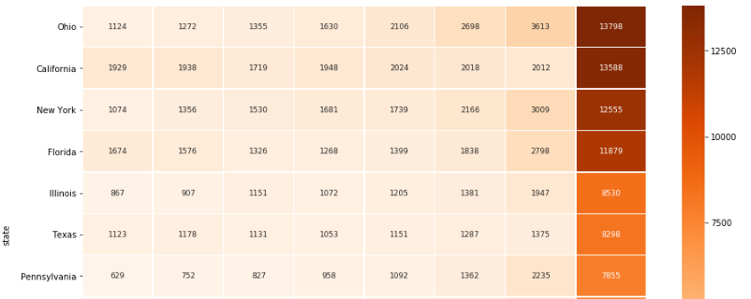
Opioid death State by State
2016, Top 15 States leading in Opioid Related deaths
The national rate of opioid overdose death has increase significantly from 6% to 418% from 2010-2016. The sharp increase has seen several states located in the East, Midwest, and Appalachian regions of the country, including Ohio, New York, Pennsylvania, Illinois, Virginia and Florida . However, one western state California shows stable rate in opioid death.

Slide 7
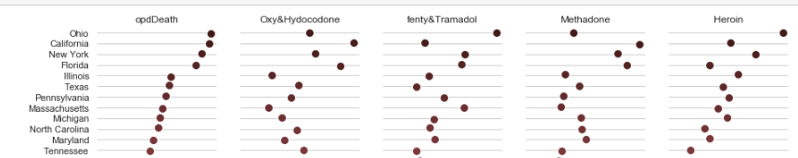
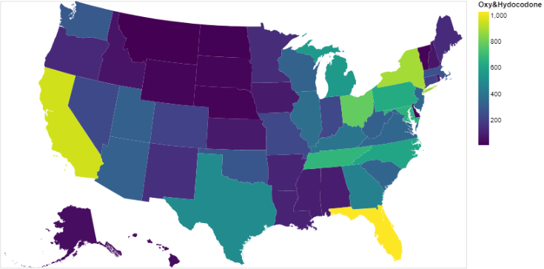
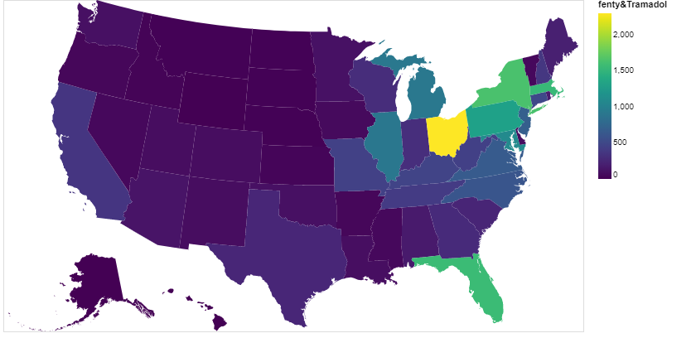
Opioid deaths by Drug type in States
Hydrocodone:
Hydrocodone is also high on the list of most abused drug in the East, Midwest and Western states. Oxy/Hydrocodon alone contributed 43% opioid overdose death in 2016. Hydrocodone deaths are high in California, Florida, Ohio, New York, Pennsylvania, Massachusetts
Synthetic Opioids:
The national rate of synthetic opioid (Fentanyl) overdose deaths increased to 256% from 2013 to 2016. This rapid rise is reflected in Ohio, Florida, New York, Illinois, Pennsylvania, Massachusetts, Michigan and Maryland.

Slide 8
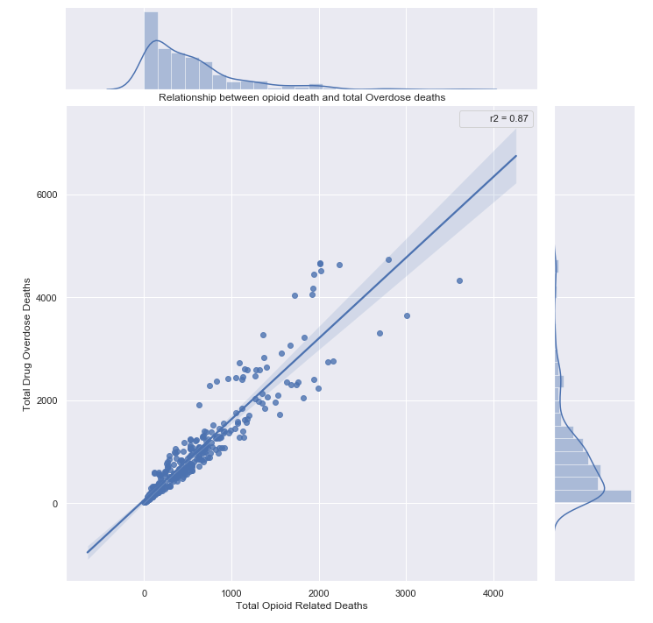
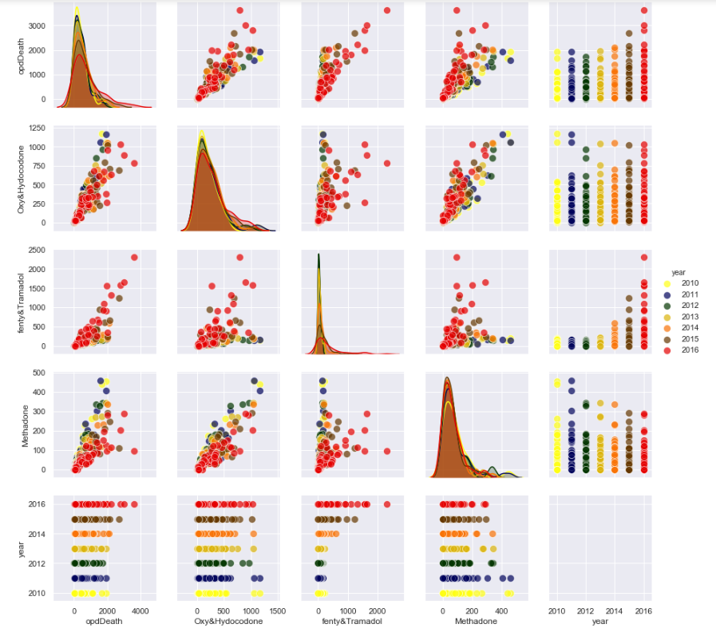
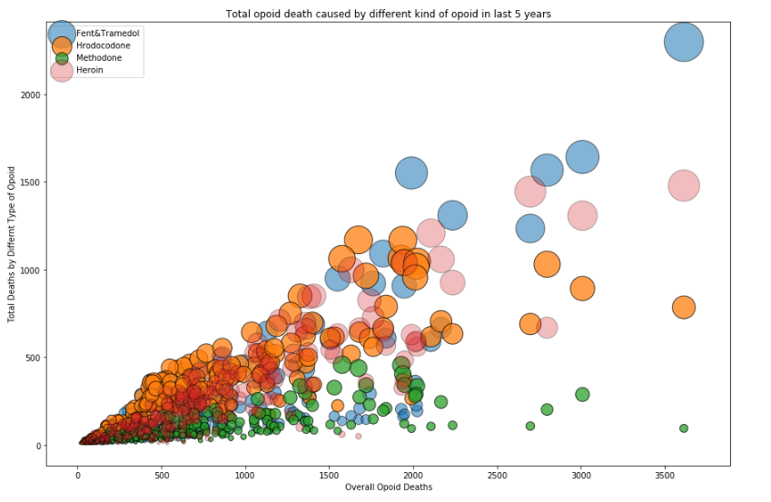
Is there any relationship between Opioid deaths vs overdose death ?

